Slide 1
Приложение 4 / Appendix 4
Data Science
Gene Expression and Lipid Composition of the Postmortem Brains of Patients with Schizophrenia
Student: Mikhail Zybin
Research Advisor: Philipp Khaitovich
Jaunary, 2023
Slides should be numbered

Slide 2
General problem / Introduction /
Background
- psychiatric disorder with a convoluted etiology and a lifetime prevalence of 0.84%.
- an interplay between genetic, epigenetic, and environmental risk factors is involved in SZ etiology.
- symptoms of SZ: positive, negative, and cognitive symptoms.
Notes:
Phrases you may find useful:
The area of my research covers …
Today … has been already studied in the field.

Slide 3
General problem / Introduction /
Background
The positive symptoms
delusions and hallucinations
the negative symptoms are
a loss of typical affective functions
and the most prominent cognitive symptoms of SZ are deﬁcits in attention and executive functioning
Notes:
Phrases you may find useful:
The area of my research covers …
Today … has been already studied in the field.

Slide 4
General problem / Introduction /
Background
Molecular mechanisms of schizophrenia are still poorly inderstood.
For the sake of simplicity let us not go into details on what lipids are. This is a specific broad class of molecules.
Genes: structural and functional units of DNA
Expression – reading the information from the gene and building a corresponding protein
We can measure it
Different brain regions have different sets of functions and processes
Notes:
Phrases you may find useful:
The area of my research covers …
Today … has been already studied in the field.

Slide 5
General problem / Introduction /
Background
There is no exact detailed picture about what is happening on a molecular level in various brain regions of people with SZ
Notes:
Phrases you may find useful:
The area of my research covers …
Today … has been already studied in the field.

Slide 6
Aim and objectives
The goal of this research is to find out what genes, what lipids in what brain regions are connected to schizophrenia.
- identify the most relevant regions, genes and lipids from the available data, so
- potential future experiments on molecular mechanisms of SZ would be able to rely only on a small subset of regions, genes and lipids.
- We want to see whether certain genes or lipids contain most of the necessary signal that distinguishes healthy brains from SZ brains.
Notes:
The overall purpose of the work is to …
The objectives of the present research run as follows:
1…
2…
3…

Slide 7
Aim and objectives
Help for the possible experiments in the future
- more people
- small subset of relevant brain regions, lipids and genes
Notes:
The overall purpose of the work is to …
The objectives of the present research run as follows:
1…
2…
3…

Slide 8
Methods
- the number of subjects (people) in significantly smaller than the number of features (gene expressions and lipid levels),
- dimensionality reduction methods such as PCA and tSNE.
- feature extraction and visualization
- finding of “support” genes with which most other genes are correlated

Slide 9
Methods
- each region and each gene: 4 healthy data points and 4 SZ points (same for lipids)
- points as coming from some probability distributions
- what useful estimates of these distributions can be made
- normal distribution by mean and variance
- discrete uniform distribution over given points
- data augmentation by creating synthetically generated data
- data augmentation gives an opportunity of ML

Slide 10
Methods
Batch-effect removal
Check various normalization methods

Slide 11
Methods
- statistical tests (Mann-Whitney, Student’s T-test, Welch’s t-test, Kruskal–Wallis test, Dunn's test, Conover–Iman test...)
- methods for multiple testing correction (Bonferroni...)
Genes identified in this manner will be analyzed using Gene Ontology enrichment software. Functional annotation of lipids will also be needed

Slide 12
Methods
Genes identified in this manner will be analyzed using Gene Ontology enrichment software. Functional annotation of lipids will also be needed using databases such as SwissLipids
- a set of genes that are up-regulated under certain conditions → which metabolic paths or biological functions are over-represented (or under-represented) there

Slide 13
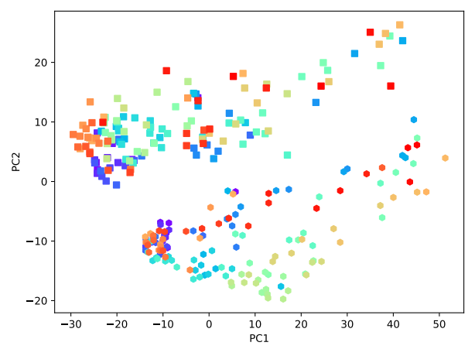
Results
Every region of every brain (4 healthy people, 4 SZ, 35 regions)
Squares – SZ
Hexagons - healthy

Slide 14
Results
Equal variance assumtion does not hold (more variance within SZ specimens)
For each region we have identified genes that are significantly more expressed and statistically less expressed
Two-stage Benjamini/Hochberg method (controlling FDR)
9914 7 – batch effect

Slide 15
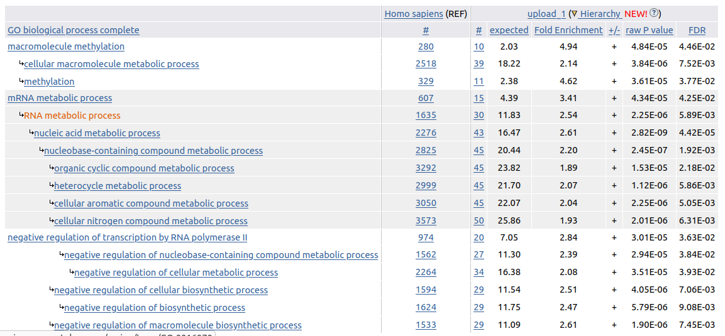
Results
Example GO output

Slide 16
Results
Can brain region be a label?
Random Forest Classification
Accuracy just 0.26
So, no point in region prediction

Slide 17
Discussion of results
- Small number of samples and big number of features
- Need to be careful with multiple testing correction (might be hard to reach statistical significance)
- Unable to apply healthy/SZ classification directly

Slide 18
Discussion of results
Linear separability shows that there is a meaningful signal in the data, although it might be due to batch effect

Slide 19
Discussion of results
- more research is needed on what stattests are most applicable here

Slide 20
Scientific novelty
Best research on the same topic
- 5 regions (Entorhinal cortex, prefrontal cortex, amygdala, corpus callosum, hippocampus)
- only Fatty Acids
- questionable usage of multiple testing correction
- good source of hypotheses for us to verify
- we have more brain regions, more lipid classes, and gene expression
- can combine

Slide 21
Conclusions
Brains of healthy people and people with SZ have different lipid composition and gene expression, which is possible to notice and measure using statistical tools.
Notes:
Phrases you may find useful:
All these results suggest that …
We can conclude that …
Taken together, these results point to three conclusions …
To sum up, …
Although it is still too early to draw a definite conclusion, it can be stated that …
Although the obtained data are limited, we may conclude that

Slide 22
Outlook
We are planning to write a paper about this topic and share our insights with the research centers that are doing the actual experiments.
Notes:
Phrases you may find useful:
The achieved results indicate that the work along the same line should proceed. Thus, the long-term results of the project are to …

Slide 23
Acknowledgements
Maria Osetrova, PhD student at Skoltech Center of Life Sciences
Provided the dataset and explanation of its file structure
Notes:
Phrases you may find useful:
I would like to express my gratitude to … who <provided smth /assisted in smth/ conducted smth/ etc.>
Thank you for your attention. Now I’m ready to answer your

